Slide 1
Ggplot2 and interactive graphics with R
Christophe Ladroue
SECTION 02
VIDEO 05
Boxplots
www.PacktPub.com

Slide 2
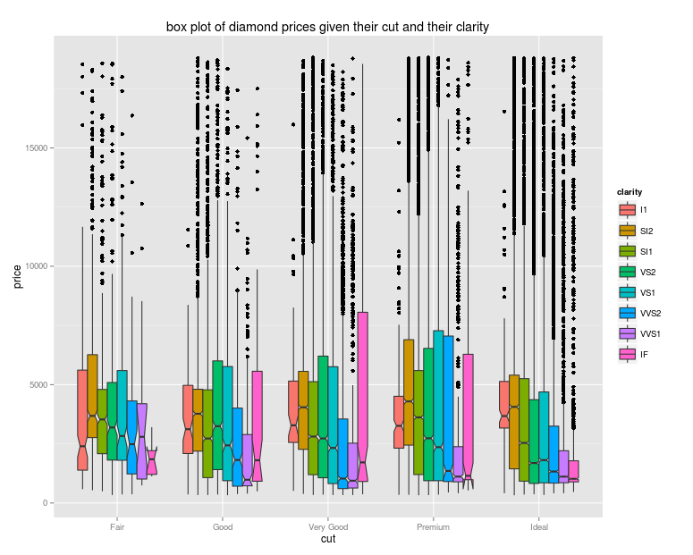
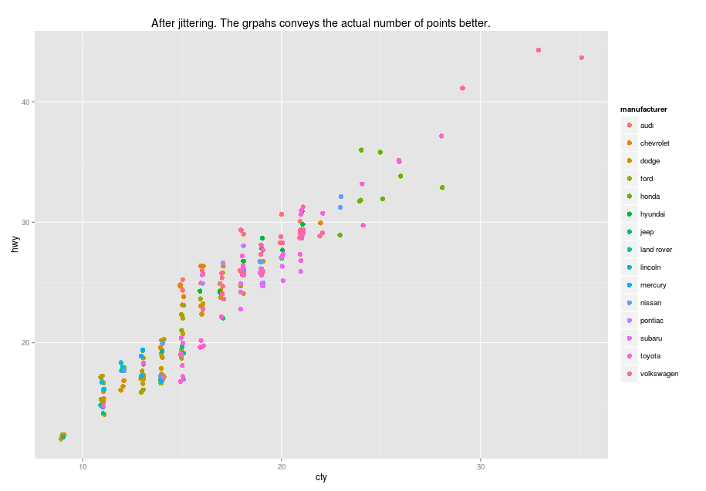
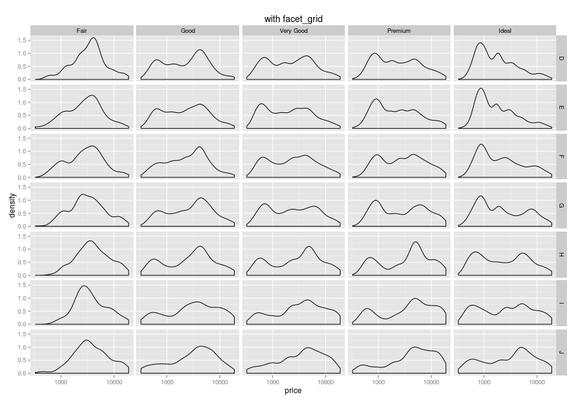
In this video we took a look at
how boxplots summarise a whole distribution with a few values.
how they can be used to compare many distributions at once.
Next: conveying more information

